Slide 1

Strings: length; Traversal; Comparison
Python Programming | Loops, string, files, list, dictionaries and tuples
Course: Python Programming | Chapter: Loops, string, files, list, dictionaries and tuples | Program: Bachelor of Computer Science and Engineering
DISCOVER · LEARN · EMPOWER
Notes:
Welcome everyone to today's session on Python Strings. We will focus specifically on how to measure string length, traverse through characters, and compare different strings. These are fundamental operations you will use in almost every Python program you write. Let's begin our journey into mastering string manipulation.

Slide 2
Course Outcomes
SLIDE 2 / 14
Course Outcome
CO | BT LEVEL | DESCRIPTION
CO1 | BT1 | Understand the syntax, control structures, and basic constructs of Python programming language
CO2 | BT3 | Apply functions, modules, and exception handling for modular program development
CO3 | BT3 | Implement data structures including lists, tuples, dictionaries, and sets for efficient data processing
CO4 | BT4 | Analyze and manipulate files, strings, and perform data handling operations
CO5 | BT5 | Design and develop real-world applications integrating multiple Python concepts
Chandigarh University
2 / 14
Notes:
Today's lecture directly supports two specific Course Outcomes. First, CO3 requires you to implement data structures, and strings are a core sequence type alongside lists and tuples. Second, CO4 focuses on analyzing and manipulating strings, which is the exact skill we are practicing today. Mastering these concepts ensures you meet both outcomes effectively.

Slide 3
Learning Objectives
SLIDE 3 / 14
Learning Outcomes
1
Define the concept of string length and its significance in data processing.
2
Demonstrate how to traverse a string using loops and indexing.
3
Explain the rules governing string comparison operations in Python.
4
Identify common pitfalls when comparing strings with case sensitivity.
5
Apply length and traversal techniques to solve basic text problems.
Chandigarh University
3 / 14
Notes:
By the end of this session, you will be able to define string length and explain why it matters for memory allocation. You will learn to traverse strings using loops, which is essential for processing text character by character. We will also clarify how Python compares strings, a common source of confusion for beginners. Finally, you will apply these skills to solve practical text processing problems.

Slide 4
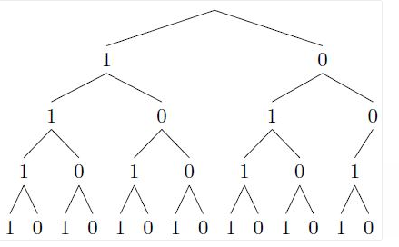
Lecture
SLIDE 4 / 14
Understanding String Length
1
The len() function returns the total number of characters in a string.
2
Length includes spaces, punctuation, and special characters within the string.
3
An empty string has a length of zero, not null or undefined.
4
Length is calculated based on Unicode code points for each character.
5
Knowing length helps prevent index out of range errors during traversal.
Solved Use a tree diagram to find the number of bit strings | Chegg.com
Chandigarh University
4 / 14
Notes:
Think of string length as the total count of items in a row. If you have the string 'Hello', the length is 5 because there are five characters. Even if the string contains spaces like 'Hi there', the space counts as one character. This function is crucial because it tells you exactly how many items you are working with before you start processing.

Slide 5
Lecture
SLIDE 5 / 14
Traversing Strings with Loops
1
Traversal means visiting every character in a string sequentially from start to end.
2
Use a for loop to iterate directly over each character in the string.
3
Use a while loop with an index variable to access characters by position.
4
The range() function generates indices from 0 up to length minus one.
5
Traversal allows you to modify or analyze each character individually.
Chandigarh University
5 / 14
Notes:
Traversal is like reading a book page by page; you must visit every single character. You can use a for loop which is simpler, or a while loop where you manually control the index. For example, if you want to print every character, you loop from index 0 to the length minus one. This process is the foundation for more complex string manipulations later.

Slide 6
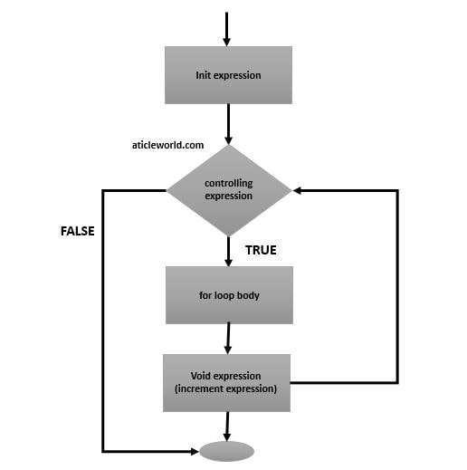
Worked Example
SLIDE 6 / 14
Traversal Logic
GOVERNING EQUATION
Example: String text = 'Data' has length 4 with indices 0 to 3
1
Loop starts at index 0 accessing 'D', then 1 accessing 'a'.
2
Iteration continues at index 2 for 't' and index 3 for 'a'.
3
Loop terminates when the index equals the string length value.
4
Total iterations equal the length of the string processed.
Source: aticleworld.com
Chandigarh University
6 / 14
Notes:
Let's look at a concrete example with the word 'Data'. The length is 4, so we have indices 0, 1, 2, and 3. The loop starts at 0, printing 'D', then moves to 1 for 'a'. It continues until index 3, printing the final 'a', and stops before index 4. This ensures we process exactly four characters without going out of bounds.

Slide 7
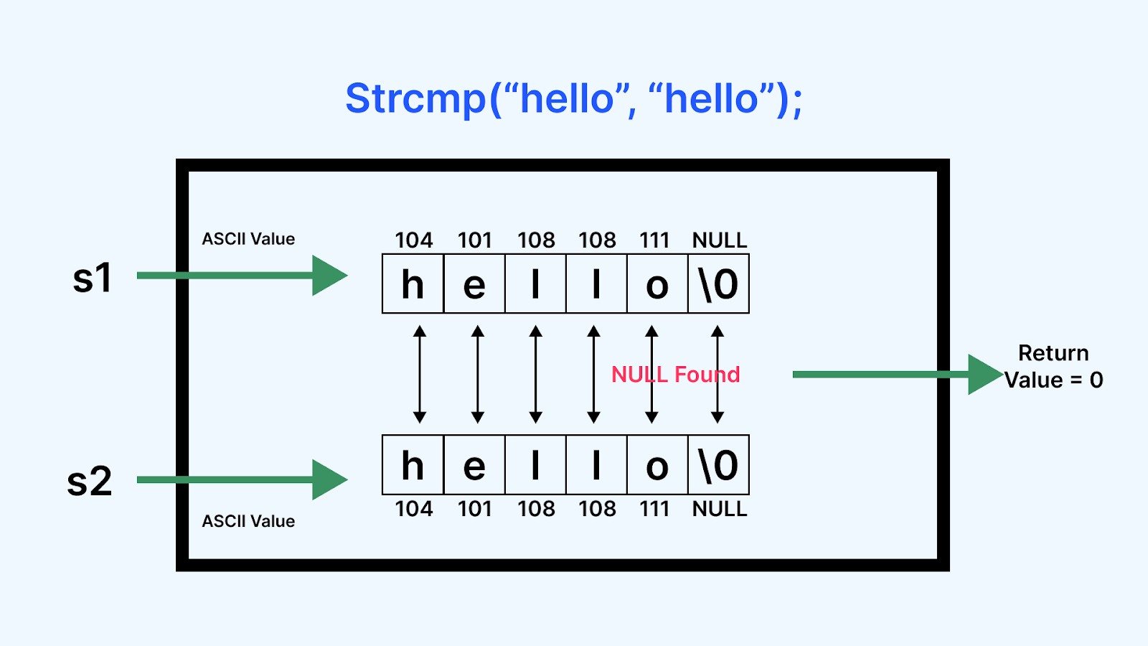
Lecture
SLIDE 7 / 14
String Comparison Rules
1
Strings are compared character by character from left to right.
2
Comparison uses ASCII or Unicode values for each character involved.
3
The first differing character determines the result of the comparison.
4
Shorter strings are considered smaller if they are a prefix of a longer one.
5
Comparison operators include equals, not equals, greater than, and less than.
Source: d2o2utebsixu4k.cloudfront.net
Chandigarh University
7 / 14
Notes:
When Python compares strings, it does not look at the whole word at once. It compares the first character of both strings. If they match, it moves to the second character, and so on. The first character that is different decides which string is larger. This is why 'Apple' is less than 'Banana' because 'A' comes before 'B' in the alphabet.

Slide 8
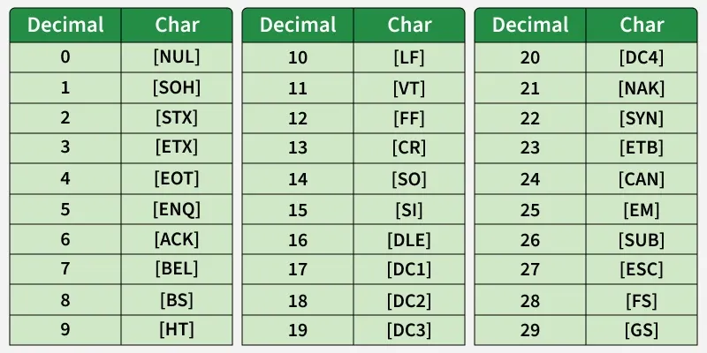
Lecture
SLIDE 8 / 14
Case Sensitivity in Comparison
1
Uppercase letters have lower ASCII values than lowercase letters.
2
'A' is considered less than 'a' in standard string comparison.
3
Direct comparison treats 'Hello' and 'hello' as completely different strings.
4
Use the lower() or upper() method to normalize strings before comparing.
5
Ignoring case is essential for user input validation and search operations.
Source: media.geeksforgeeks.org
Chandigarh University
8 / 14
Notes:
A common pitfall is assuming 'Hello' equals 'hello'. In Python, they are not equal because uppercase 'H' has a different value than lowercase 'h'. Specifically, 'A' is 65 while 'a' is 97 in ASCII. This means 'Apple' is actually less than 'apple'. Always convert strings to the same case if you want a case-insensitive comparison.

Slide 9

Common Pitfall
SLIDE 9 / 14
Index Errors
1
Accessing an index equal to the string length causes an IndexError.
2
Valid indices range from 0 to length minus one only.
3
Negative indices count from the end, with -1 being the last character.
4
Always check string length before using a loop index variable.
5
Using len() prevents crashes when traversing dynamic string inputs.
Source: blogger.googleusercontent.com
Chandigarh University
9 / 14
Notes:
One of the most frequent errors is trying to access the character at the exact length of the string. If a string has length 5, the last valid index is 4. Trying to access index 5 will crash your program. Always remember that indices start at 0, so the highest index is always length minus one. Using negative indices is a safe way to access the end of the string.

Slide 10
Common Pitfall
SLIDE 10 / 14
Immutability
1
Strings in Python are immutable and cannot be changed in place.
2
Attempting to assign a new character to an index raises TypeError.
3
To modify a string, you must create a new string object entirely.
4
Concatenation creates a new string rather than modifying the original.
5
Use list conversion if you need to modify characters frequently.
Chandigarh University
10 / 14
Notes:
You cannot change a single character in a string directly. If you try to do 'text[0] = 'X'', Python will throw an error because strings are immutable. This means the original string stays exactly the same. To change it, you must create a completely new string with the desired changes. This design ensures data safety but requires different handling for modifications.

Slide 11
Practical Application
SLIDE 11 / 14
Counting Vowels
1
Traverse a string to identify and count vowel characters specifically.
2
Initialize a counter variable to zero before starting the traversal loop.
3
Check each character against a set of vowels: a, e, i, o, u.
4
Increment the counter whenever a match is found during iteration.
5
This pattern applies to counting any specific character in text.
Chandigarh University
11 / 14
Notes:
Let's apply traversal to a real problem: counting vowels. You start with a counter at zero. As you loop through the string, you check if the current character is a vowel. If it is, you add one to your count. This simple logic is the basis for more complex text analysis tasks like word frequency counting or pattern matching.

Slide 12
Practical Application
SLIDE 12 / 14
Palindrome Check
1
A palindrome reads the same forwards and backwards.
2
Compare the string with its reverse using slicing or traversal.
3
Use the equality operator to check if both versions match exactly.
4
Case sensitivity must be handled before performing the comparison.
5
This logic is used in data validation and game development.
Chandigarh University
12 / 14
Notes:
Another great example is checking for palindromes like 'RADAR'. You can reverse the string and compare it to the original. If they are identical, it is a palindrome. Remember to handle case sensitivity first, so 'Radar' is treated correctly. This demonstrates how traversal and comparison work together to solve logical problems.

Slide 13
Lecture
SLIDE 13 / 14
Key Takeaways
1
Use len() to get the character count including spaces and symbols.
2
Traverse strings using loops to access each character by index.
3
String comparison is case-sensitive and based on ASCII values.
4
Strings are immutable; you cannot change characters in place.
5
Always validate indices to avoid out-of-range errors during traversal.
Chandigarh University
13 / 14
Notes:
To summarize, remember that len() gives you the total count of characters. Traversal allows you to process each character sequentially using loops. Comparison is strict and case-sensitive, relying on underlying character codes. Finally, always remember that strings are immutable and you must check your indices to prevent errors. These four points are the core of string manipulation.

Slide 14
Lecture
SLIDE 14 / 14
References
PYTHON
A Practical Learning Approach, 1st Edition — T.S. Murugesh, Shriram K. Vasudevan, Sini Raj Pulari
• Learning Python, 6th Edition — Mark Lutz
• Starting Out with Python, Global Edition, 6th Edition — Tony Gaddis
• Introduction to Python Programming and Data Structures, 3rd Edition — Y. Daniel Liang
Chandigarh University
14 / 14
Notes:
For further reading, I recommend the four textbooks listed on this slide. Mark Lutz's book is excellent for deep dives into Python. Tony Gaddis provides a great introduction for beginners. Y. Daniel Liang's book covers data structures well. Finally, the practical approach by Murugesh et al. offers excellent exercises. Please refer to these for more examples and practice problems.

